Slide 1
Jitter

Slide 2
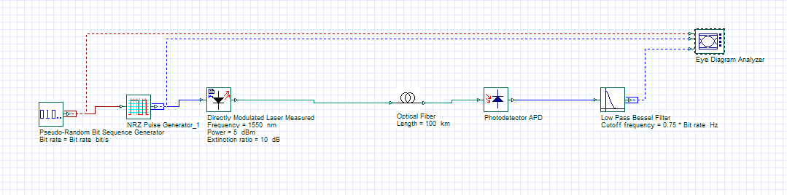
The effect of Samples per bit to jitter value（100km）
Bit rate：100Mbps
Bit sequence： 1024bit

Slide 3
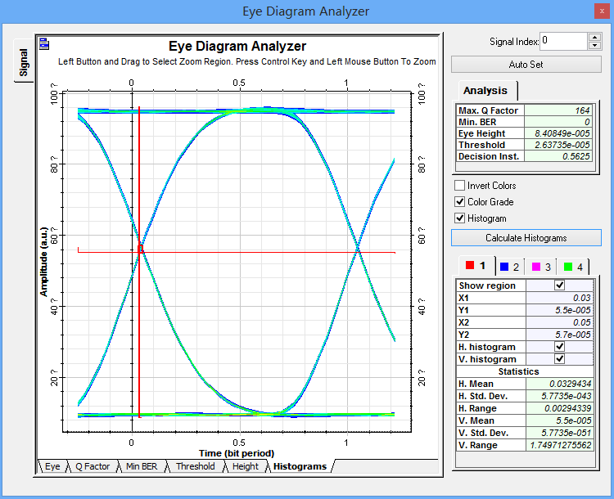
32 samples per bit
Jitter：29.4339ps

Slide 4
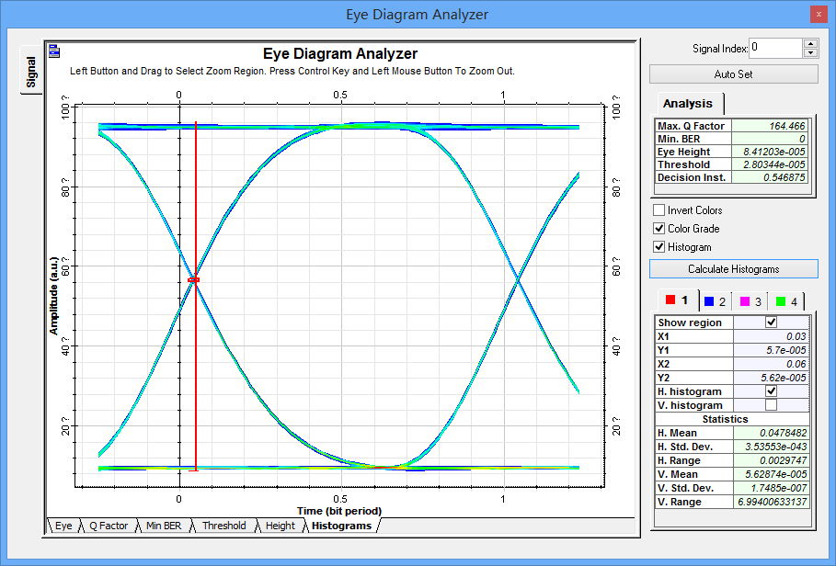
64samples per bit
29.747ps

Slide 5
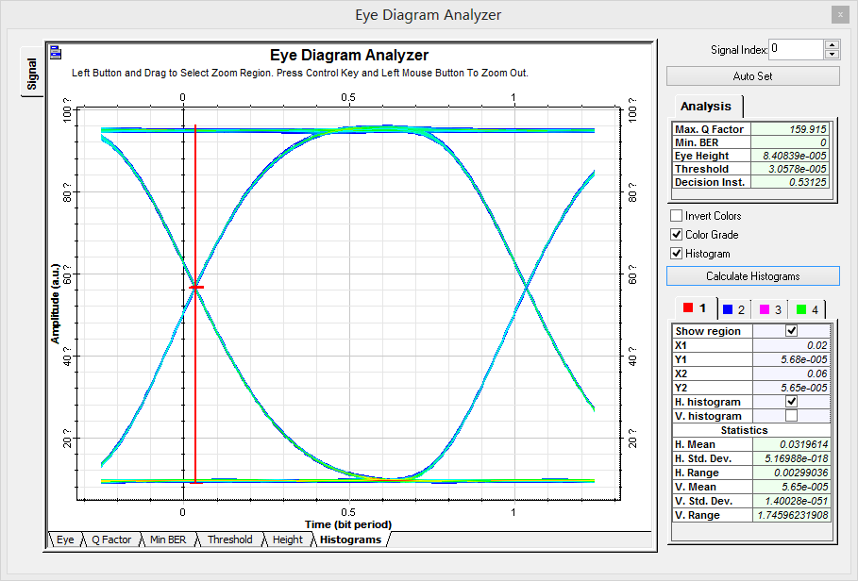
128 samples per bit
29.9036ps

Slide 6
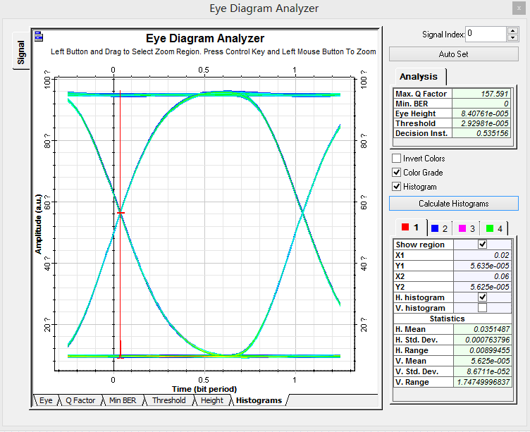
256samples per bit
89.9455ps

Slide 7
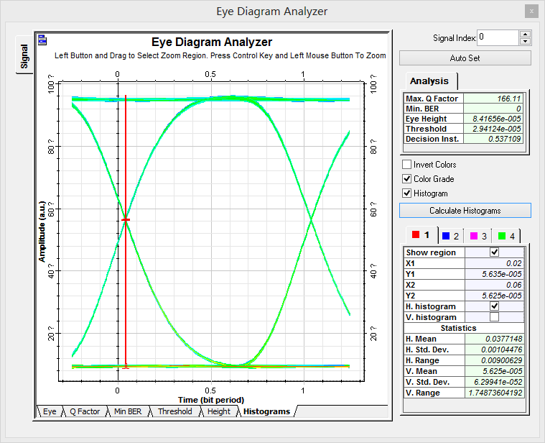
512samples per bit
90.0629ps

Slide 9
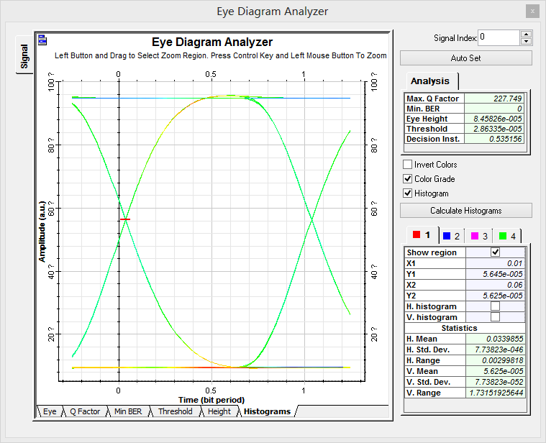
The effect of BIT
RATE to jitter value（100km）
BIT RATE:1Mbps
256 samples per bit
Jitter：2.99818ns

Slide 10
100Mbps
256samples per bit
89.9455ps

Slide 11
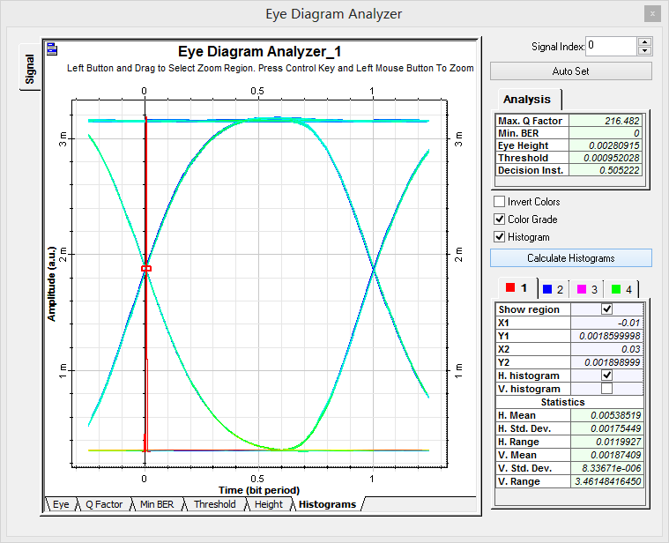
1Gbps
256 samples per bit
11.9927ps

